Slide 1
DMA Direct Memory Access Presented by Liew Ee Mei

Slide 2
What is DMA
It can be reading data from peripheral unit like ADC and writing values to RAM. In other case maybe you need send chunks of data using SPI. Again you need to read it from RAM and constantly write to SPI data register and so on. When you do this using processor – you loose a significant amount of processing time.
DMA does data transfers between memory locations without need of CPU.

Slide 3
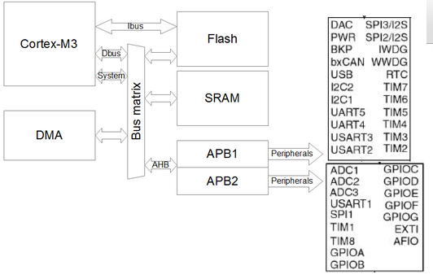
DMA block
DMA1
DMA2

Slide 4
why do you need a special module for this transfer?
interrupt method can become quite inefficient, because there is some overhead associated with entering and exiting the interrupt handlers.
DMA to watch out for incoming bytes on the peripheral and to store them memory as they come in, and to only alert the CPU if at all have been received
it allows you to transfer data without the involvement of the CPU ( that’s where the “direct” comes from).

Slide 5
Setting up dma
DMA stream/channel
Stream priority
Source and destination addresses (where you’re copying data from/to)
Transfer mode
Transfer size (only when DMA is the flow controller)
Source/destination address incrementing or non-incrementing
Source and destination data width
Transfer type
FIFO mode
Source/destination burst size
Double-buffer mode
Flow control

Slide 6
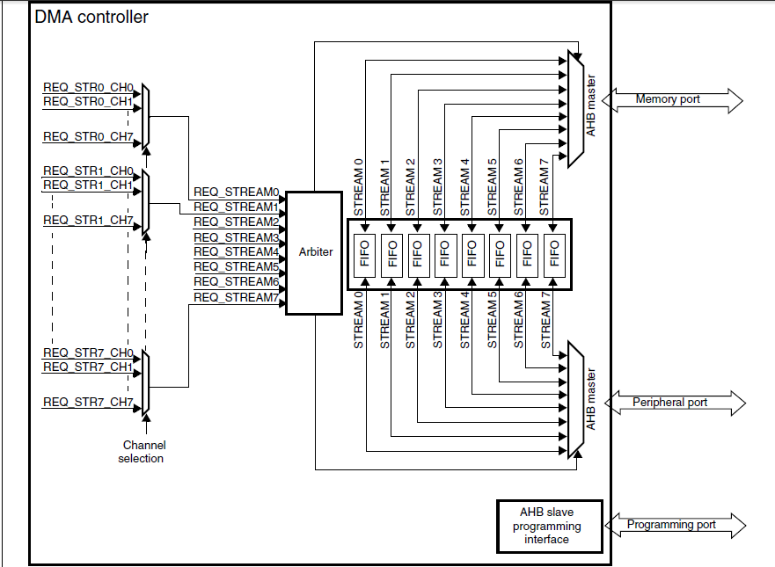
DMA controller

Slide 7
DMA main features
there are actually two DMA controllers(almost identical).
The main difference between them is that only the DMA2 controller can perform memory-to-memory transfers.
DMA1 is connected to the APB1 peripherals
DMA2 is connected to the APB2 peripherals
Each DMA controller has 8 separate streams.
Each stream itself needs to be associated with one of 8 channels.
channels carry the signal to the data are ready to be transferred. called “DMA requests”

Slide 8
The following subsections provide a detailed description of each DMA transfer property.

Slide 9
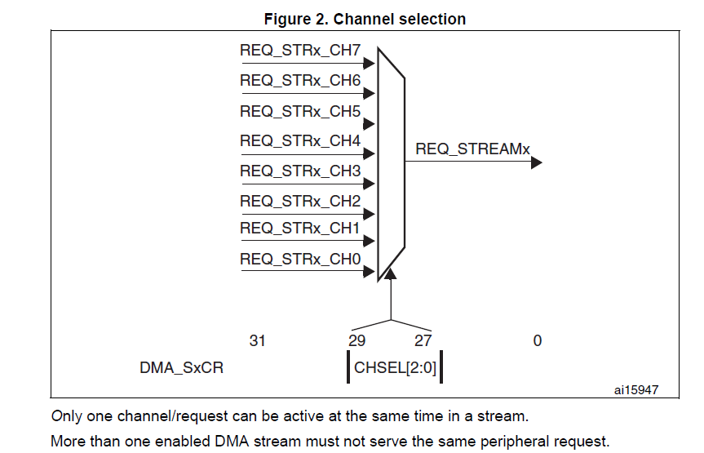
Channel Selection
The selection is controlled by the CHSEL[2:0] bits in the DMA_SxCR register. This selection is software-configurable and allows several peripherals to initiate DMA requests.
The 8 requests from the peripherals (TIM, ADC, SPI, etc.) are independently connected to each channel and depends on the product implementation. Only one channel/request can be active at the same time in a stream. More than one enabled DMA stream must not serve the same peripheral request.

Slide 10
STREAM
Table 2 and Table 3 show DMA1 and DMA2 requests mapping. The tables give the available configuration of DMA streams/channels versus peripheral requests.
DMA request mapping is designed in such a way that the software application has more flexibility to map each DMA request for the associated peripheral request, and that most of the use case applications are covered by multiplexing the corresponding DMA streams and channels.

Slide 11
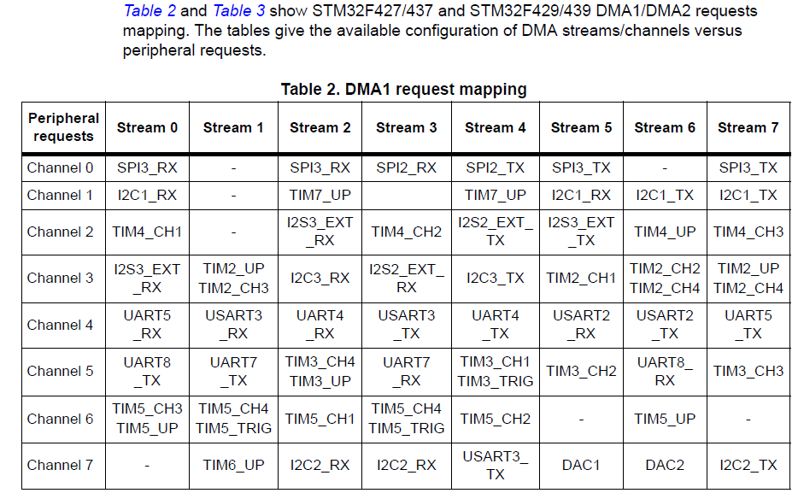
Which stream and channel do I need to use?
These tables show which of the DMA streams a particular peripheral is connected to and via which channel.
Example :
DMA request for the transmit signal of SPI3 module is located on channel 0 of DMA1 stream 0.

Slide 12
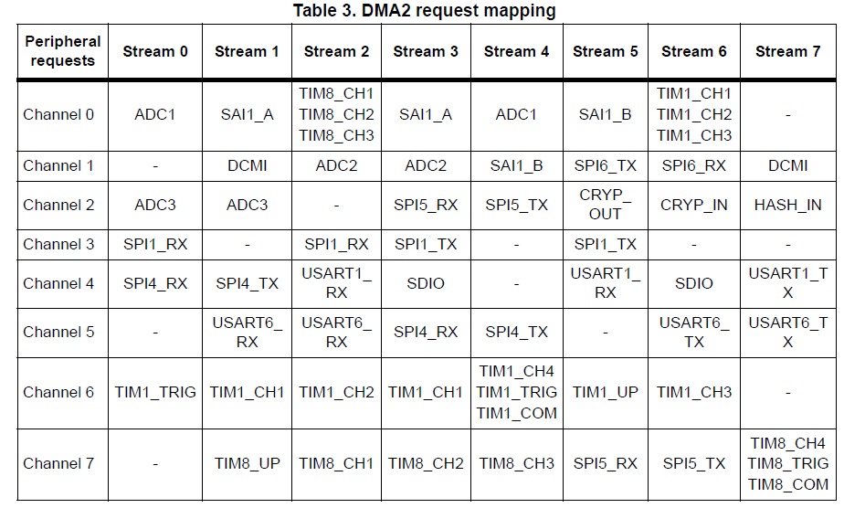

Slide 13
DMA Priority
DMA channels can be assigned one of four priority level:
very high, high, medium and low.
if two same priority channels are requested at same time – the lowest number channel gets priority.

Slide 14
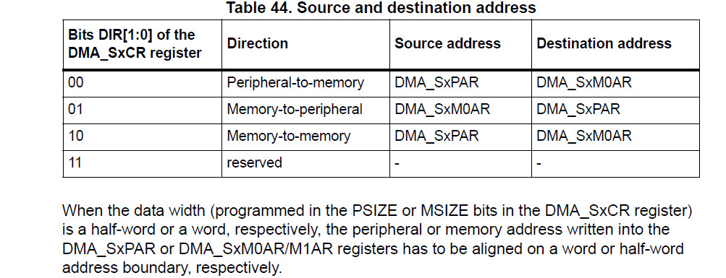
Source and destination addresses
A DMA transfer is defined by a source address and a destination address. Both the source and destination should be in the AHB or APB memory ranges and should be aligned to transfer size.

Slide 15
Transfer mode
DMA is capable of performing three different transfer modes:
• Peripheral to memory
• Memory to peripheral
• Memory to memory (only DMA2 is able to do such transfer, in this mode, the circular and direct modes are not allowed.)

Slide 16
Transfer size
The transfer size value has to be defined only when the DMA is the flow controller. In fact, this value defines the volume of data to be transferred from source to destination.
The transfer size is defined by the DMA_SxNDTR register value and by the peripheral side data width. Depending on the received request (burst or single), the transfer size value is decreased by the amount of the transferred data.

Slide 17
Incrementing source/destination address
Peripheral and memory pointers can optionally be automatically post-incremented or kept constant after each transfer depending on the PINC and MINC bits in the DMA_SxCR register.
Increment mode Disable: source or destination data are accessed a single register.

Slide 18
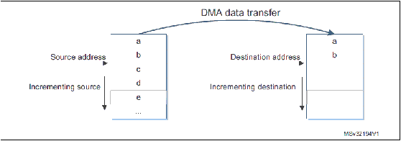
Incrementing source/destination address
Increment mode Enable: the address of the next transfer will be the address of the previous one incremented by 1 (for bytes), 2 (for half-words) or 4 (for words) depending on the data width programmed in the PSIZE or MSIZE bits in the DMA_SxCR register.

Slide 19
Source and destination data width
Data width for source and destination can be defined as:
Byte (8 bits)
Half-word (16 bits)
Word (32 bits)

Slide 20
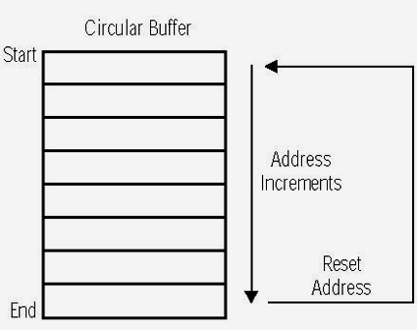
Transfer types
Circular mode: the Circular mode is available to handle circular buffers and continuous data flows (the DMA_SxNDTR register is then reloaded automatically with the previously programmed value).
Normal mode: once the DMA_SxNDTR register reaches zero, the stream is disabled (the EN bit in the DMA_SxCR register is then equal to 0).

Slide 21
DMA FIFO mode
Each stream has an independent 4-word (4 * 32 bits) FIFO and the threshold level is software-configurable between 1/4, 1/2, 3/4 or full. The FIFO is used to temporarily store data coming from the source before transmitting them to the destination.
DMA FIFO can be enabled or disabled by software; when disabled, the Direct mode is used. If DMA FIFO is enabled, data packing/unpacking and/or Burst mode can be used. The configured DMA FIFO threshold defines the DMA memory port request time.

Slide 22
DMA FIFOs implemented
The DMA FIFOs help to:
reduce SRAM access and so give more time for the other masters to access the bus matrix without additional concurrency
allow software to do burst transactions which optimize the transfer bandwidth
allow packing/unpacking data to adapt source and destination data width with no extra DMA access

Slide 23
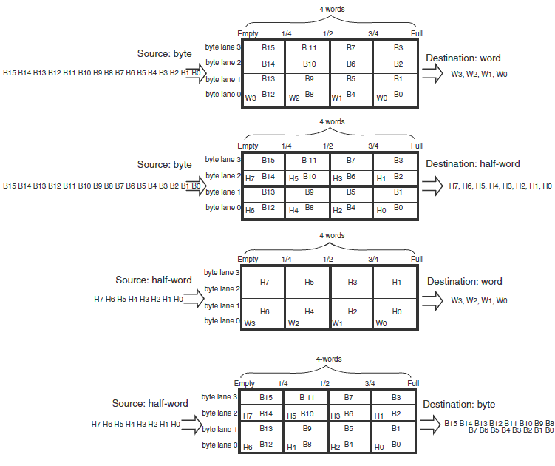

Slide 24
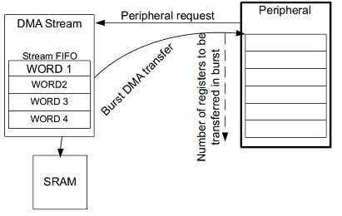
Source and destination burst size
Burst transfers are guaranteed by the implemented DMA FIFOs
DMA burst transfer

Slide 25
Source and destination burst size
In response to a burst request from peripheral DMA reads/writes the number of data units (data unit can be a word, a half-word, or a byte) programmed by the burst size (4x, 8x or 16x data unit). The burst size on the DMA peripheral port must be set according to the peripheral needs/capabilities. The DMA burst size on the memory port and the FIFO threshold configuration must match. This allows the DMA stream to have enough data in the FIFO when burst transfer on the memory port is started.

Slide 26
Double-buffer mode
A double-buffer stream works as a regular (single-buffer) stream
with the difference that it has two memory pointers
When the Double-buffer mode is enabled, the Circular mode is automatically enabled and at each end of transaction (DMA_SxNDTR register reach 0), the memory pointers are swapped.
This allows the software to process one memory area while the second memory area is being filled/used by the DMA transfer.

Slide 27
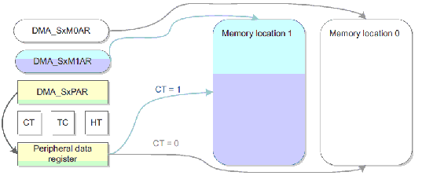
Double-buffer mode
In Double-buffer mode, it is possible to update the base address for the AHB memory port on-the-fly (DMA_SxM0AR or DMA_SxM1AR) when the stream is enabled:
When the CT (Current Target) bit in the DMA_SxCR register is equal to 0, the current DMA memory target is memory location 0 and so the base address memory location 1 (DMA_SxM1AR) can be updated.
When the CT bit in the DMA_SxCR register is equal to 1, the current DMA memory target is memory location 1 and so the base address memory location 0 (DMA_SxM0AR) can be updated.

Slide 28
Flow control
controls the data transfer length and responsible for stopping the DMA transfer
DMA as flow controller: necessary to define the transfer size value in the DMA_SxNDTR register before enabling the associated DMA stream.When a DMA request is served, the transfer size value decreases by the amount of transferred data (depending of the type of request: burst or single).When the transfer size value reaches 0, the DMA transfer is finished and the DMA stream is disabled.The amount of data to be transferred (up to 65535)
Peripheral as flow controller: data to be transferred is unknown and controlled by the source or the destination peripheral. The peripheral indicates by hardware to the DMA controller when the last data are being transferred. Only the SD/MMC peripheral supports this mode.

Slide 29
Error management 1. Transfer error:
the transfer error interrupt flag (TEIFx) is set when:
A bus error occurs during a DMA read or a write access
A write access is requested by address register in Double buffer mode whereas the stream is enabled and the current target memory is the one impacted by the write into the memory address register

Slide 30
2. FIFO error
FIFO error interrupt flag (FEIFx) is set if:
A FIFO under run condition is detected
A FIFO over run condition is detected (no detection in memory-to-memory mode because requests and transfers are internally managed by the DMA)
The stream is enabled while the FIFO threshold level is not compatible with the size of the memory burst

Slide 31
3. Direct mode error
direct mode error interrupt flag (DMEIFx) can only be set in the:
peripheral-to-memory mode while operating in direct mode and when the MINC bit in the DMA_SxCR register is cleared.
This flag is set when a DMA the previous data not yet fully transferred into the memory (because the memory bus was not granted).
In this case, the flag indicates that 2 data items were be transferred successively to the same destination address, which could be an issue if the destination is not able to manage this situation

Slide 32

Thank you ☺

